Slide 1
Project Design
Jennifer Barry
Meredith Weiner
Advisor: Professor Femister

Slide 2
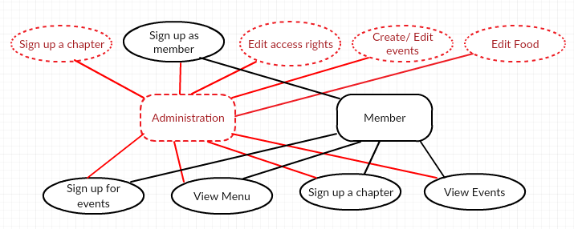
Objects and interactions

Slide 3
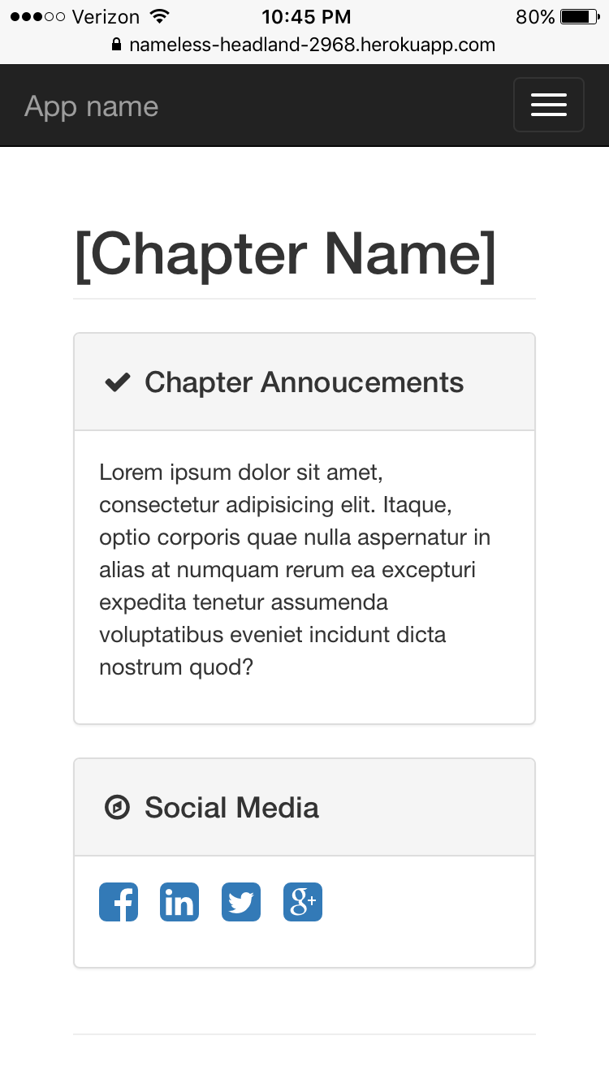
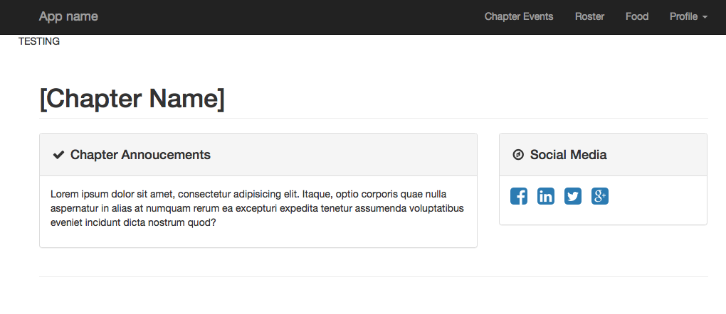
Responsiveness

Slide 4

Keep target user in mind

Slide 5
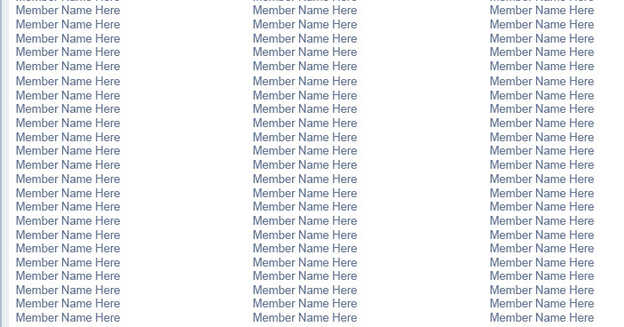

Security

Slide 6
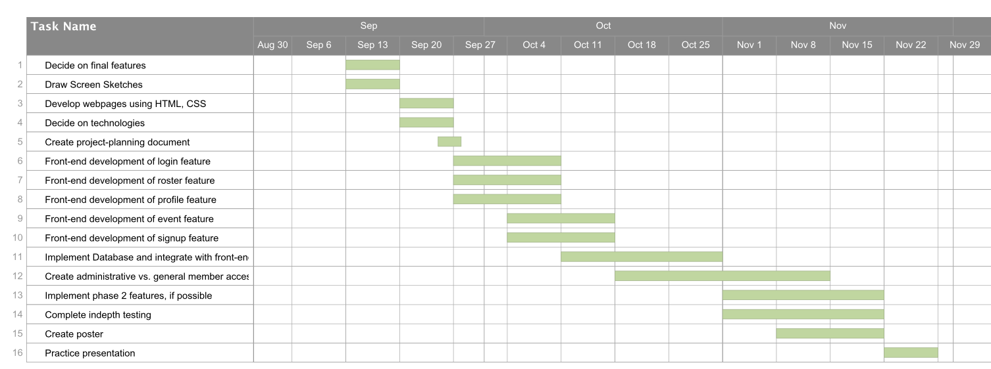
Progress

